Slide 1
CSE 4306: PRINCIPLE OF SOFTWARE ENGINEERING [OE IV]
The Problem Domain, The Software Engineering Challenges, The Software Engineering Approach. Software Process, Desired Characteristics of Software Process, Software Development process models. Software Requirements, Problem Analysis, Requirement Specifications, Functional Specification with Use Cases, Process Planning, Effort Estimation, Project Scheduling and Staffing, Software Configuration Management Plan. Design Principle, Module Level Concepts, Design Notations and Specifications, Structured Design Methodology. OO Analysis and OO Design, OO Concepts, Unified Modelling Language. Programming Principle and Guidelines, Coding Process, Testing Fundamentals, Black Box Testing, White Box Testing, Testing Process.
References:
1. Pankaj Jalote, An integrated approach to software engineering, (3e), Narosa 2005
2. Ian Sommerville, Software Engineering, Pearson, (9e), 2010
3. Rajib Mall, Fundamentals of Software Engineering (3e), PHI learning 2009
4. Roger S. Pressman, Software Engineering A Practioner’s Approach, (6e), McGraw-Hill, 2005
Department of Computer Science and Engineering, MIT

Slide 2
Faculty member Details
Manoj R
Assistant Professor-Senior Scale
CSE Dept
AB5 1st floor Faculty chamber 3,cabin no 21
Doing research in Block Chain Technology
15 years experience in Teaching
Contact me @ 9740288939
Email id- manoj.r@manipal.edu
Department of Computer Science and Engineering, MIT

Slide 3
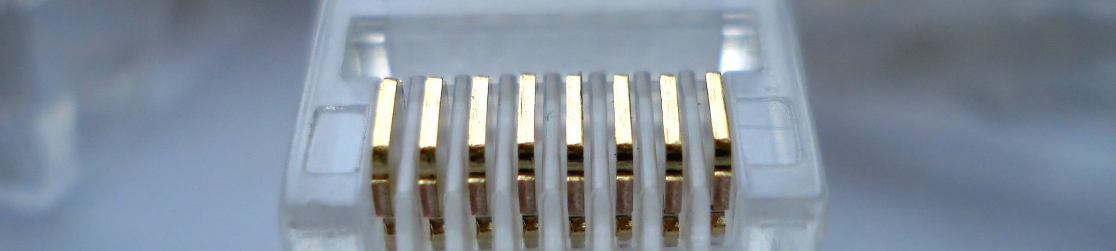
Introduction to Software Engineering

Slide 4
Overview
Learning Objectives.
What is software engineering?
Why is software engineering important?

Slide 5
By the end of this Lecture, you will...
Understand what software engineering is.
Understand why software engineering is important.
Know answers to key questions related to the software engineering discipline.

Slide 6
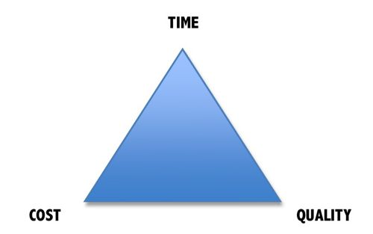
Why is Software Engineering important?
Complex systems need a disciplined approach for designing, developing and managing them.

Slide 7
Software Development Crises
Projects were:
  Late.
  Over budget.
  Unreliable.
  Difficult to maintain.
  Performed poorly.

Slide 8
Software errors….the cost
Errors in computer software can have devastating effects.

Slide 9

Software Crisis
  Example 1: 2009,Computer glitch delays flights
Saturday 3rd October 2009-London, England (CNN)
Dozens of flights from the UK were delayed Saturday after a glitch in an air traffic control system in Scotland, but the problem was fixed a few hours later.
The agency said it reverted to backup equipment as engineering worked on the system.
The problem did not create a safety issue but could cause delays in flights.
Read more at:
http://edition.cnn.com/2009/WORLD/europe/10/03/uk.flights.delayed

Slide 10
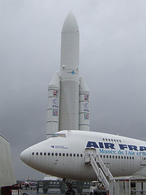
Software Crisis
  Example 2: Ariane 5 Explosion
  European Space Agency spent 10 years and $7 billion to produce Ariane 5.
  Crash after 36.7 seconds.
  Caused by an overflow error. Trying to store a 64-bit number into a 16-bit space.
  Watch the video: http://www.youtube.com/watch?v=z-r9cYp3tTE

Slide 11
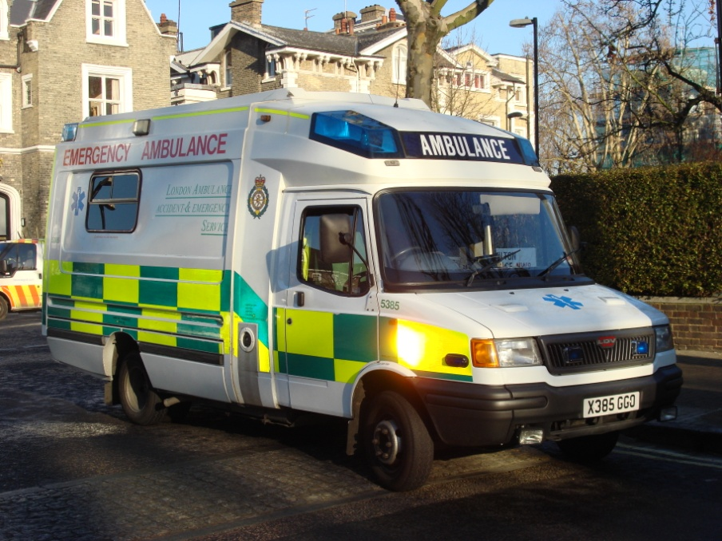
Software Crisis
  Example 3: 1992, London Ambulance Service
  Considered the largest ambulance service in the world.
  Overloaded problem.
  It was unable to keep track of the ambulances and their statuses. Sending multiple units to some locations and no units to other locations.
  Generates many exceptions messages.
  46 deaths.

Slide 12
Therefore…
A well-disciplined approach to software development and management is necessary. This is called engineering.

Slide 13

Activity
Think about all the devices and systems that you encounter in your everyday life which have software controlling them…
List as many as you can
Virtually all countries depend on complex computer-based systems.

Slide 14
IEEE Definition
“Software engineering is the application of a systematic, disciplined, quantifiable approach to the development, operation, and maintenance of software; that is, the application of engineering to software.”

Slide 15
Software Engineering
The term software engineering first appeared in the 1968 NATO Software Engineering Conference and was meant to provoke thought regarding what was then called the “software crisis”..
“.. An engineering discipline that is concerned with all aspects of software production from the early stages of system specification to maintaining the system after it has gone into use.” Sommerville, pg.7

Slide 16
Which Principles Deployed by Software Engineering Techniques to Overcome Human Cognitive Limitations?
Two important principles are profusely used:
  Abstraction
  Decomposition

Slide 17
What is Abstraction?
Simplify a problem by omitting unnecessary details.
  Focus attention on only one aspect of the problem and ignore other aspects and irrelevant details.
  Also called model building.

Slide 18
Abstraction Example
Suppose you are asked to develop an overall understanding of some country.
  Would you:
    Meet all the citizens of the country, visit every house, and examine every tree of the country?
  You would possibly refer to various types of maps for that country only.

Slide 19
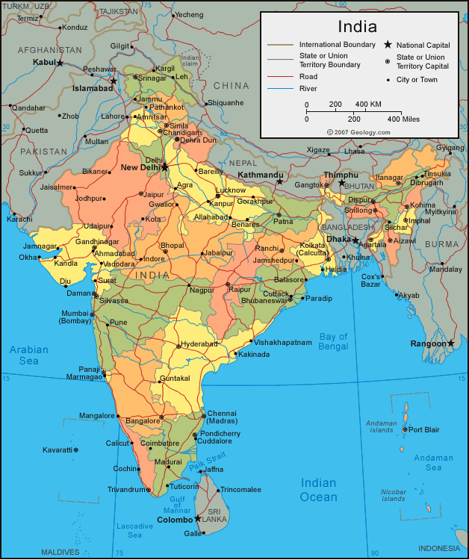
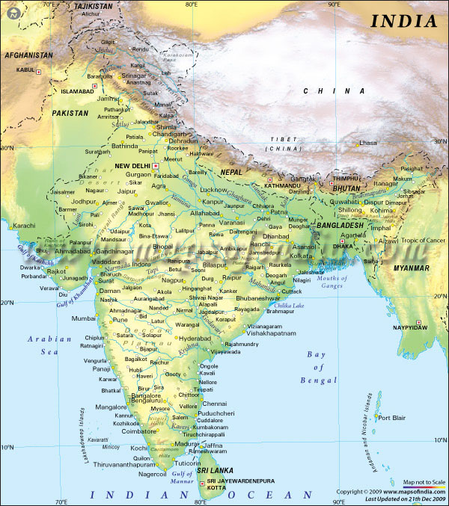
You would study an Abstraction…
A map is:
  An abstract representation of a country.
  Various types of maps (abstractions) possible.

Slide 20
Decomposition Example
Example use of decomposition principle:
  You understand a book better when the contents are organized into independent chapters.
  Compared to when everything is mixed up.

Slide 21
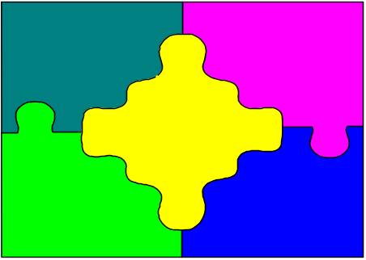
Why Study Software Engineering? (1)‏
To acquire skills to develop large programs.
  Handling exponential growth in complexity with size.
  Systematic techniques based on abstraction (modelling) and decomposition.

Slide 22
Why Study Software Engineering? (2)‏
Learn systematic techniques of:
  Specification, design, user interface development, testing, project management, etc.
  Appreciate issues that arise in team development.

Slide 23
Why Study Software Engineering? (3)
To acquire skills to be a better programmer:
    Higher Productivity
    Better Quality Programs

Slide 24
Software Crisis
It is often the case that software products:
  Fail to meet user requirements.
  Expensive.
  Difficult to alter, debug, and enhance.
  Often delivered late.
  Use resources non-optimally.

Slide 25
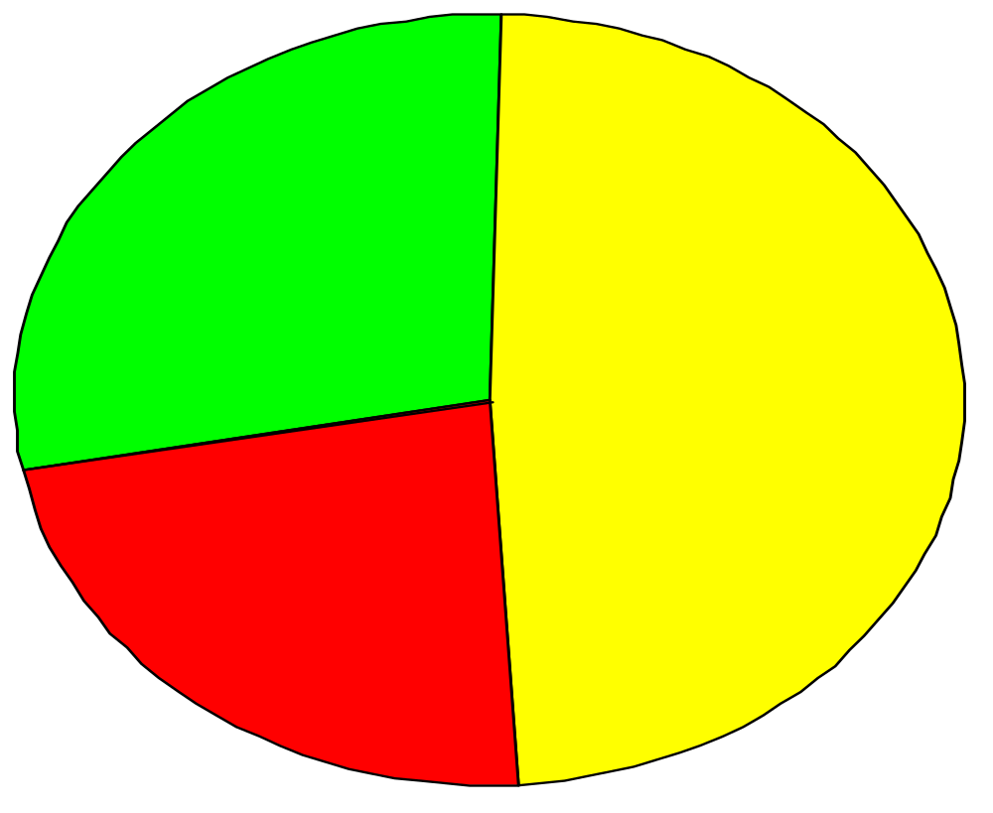
Standish Group Report
28% Successful
49% Delayed or cost overrun
23% Cancelled

Slide 26
Which Factors are Contributing to the Software Crisis?
Larger problems,
Poor project management
Lack of adequate training in software engineering,
Increasing skill shortage,
Low productivity improvements.

Slide 27
Programs versus Software Products
Large
Large number of users
Team of developers
Well-designed interface
Well documented & user-manual prepared
Systematic development
Usually small in size
Author himself is sole user
Single developer
Lacks proper user interface
Lacks proper documentation
Ad hoc development.

Slide 28
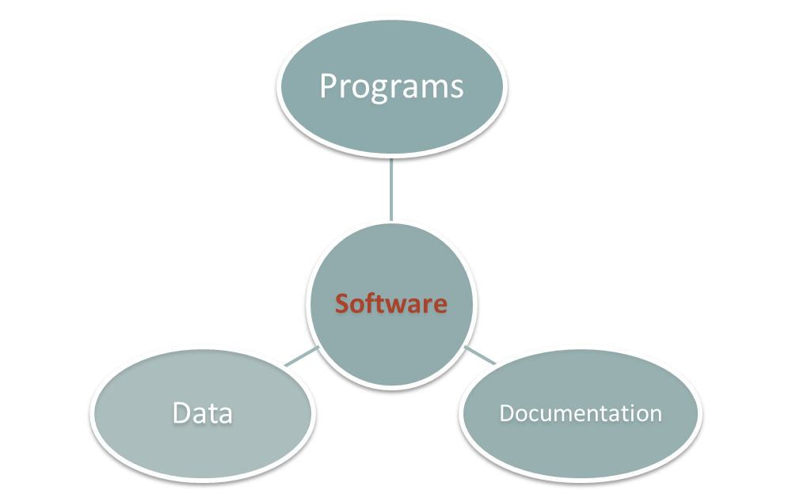
What is Software?
System Documentation
User Documentation

Slide 29
Programs versus Software Products
Usually small in size
Author himself is sole user
Single developer
Lacks proper user interface
Lacks proper documentation
Ad hoc development.
Large
Large number of users
Team of developers
Well-designed interface
Well documented & user-manual
Systematic development

Slide 30
Types of Software
Generic products.
  Stand-alone systems that are marketed and sold to any customer who wishes to buy them.
  Examples – PC software such as graphics programs, project management tools; CAD software; software for specific markets such as appointments systems for dentists.
  The specification of what the software should do is owned by the software developer and decisions on software change are made by the developer.
Customized or bespoke products.
  Software that is commissioned by a specific customer to meet their own needs.
  Examples – embedded control systems, air traffic control software, traffic monitoring systems.
  The specification of what the software should do is owned by the customer for the software and they make decisions on software changes that are required.

Slide 31
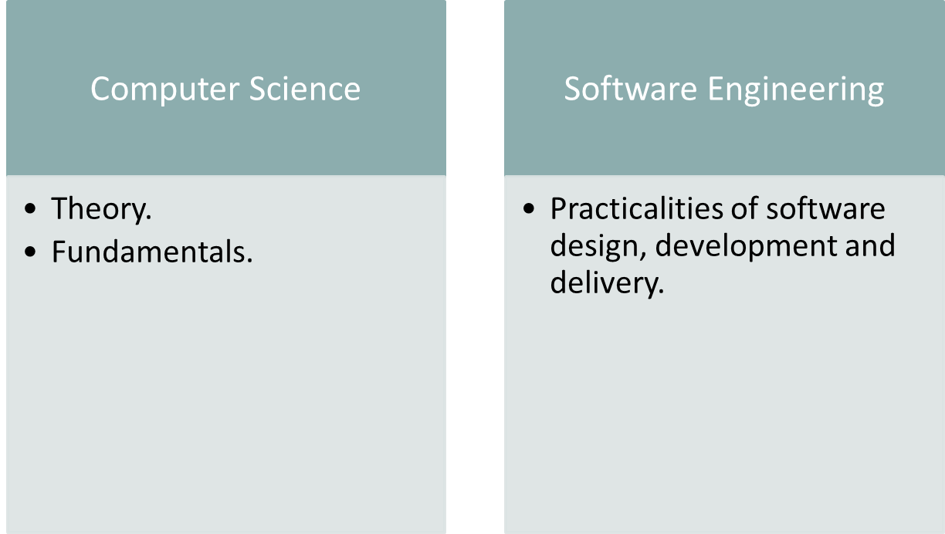
Software Engineering vs. Computer Science

Slide 32
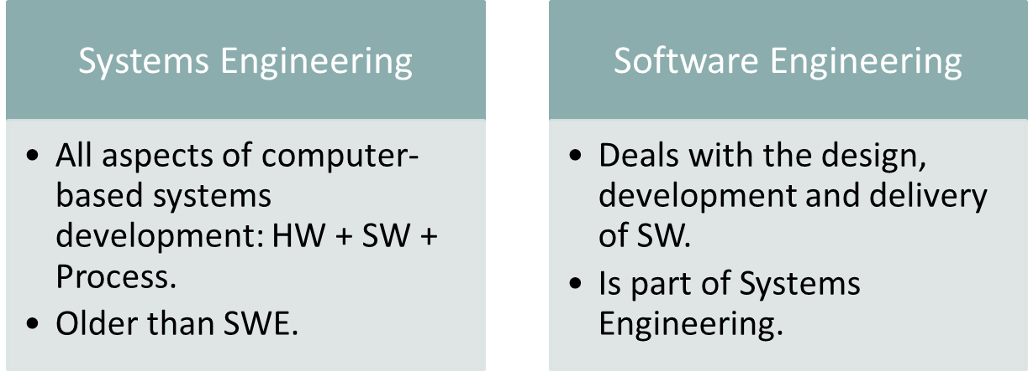
Software Engineering vs. Systems Engineering
Systems Engineering:
Interdisciplinary engineering field (computer, software, and process eng.).
Focuses on how complex engineering projects should be designed and managed.

Slide 33
Frequently asked questions about software engineering
Question | Answer
What is software? | Computer programs and associated documentation. Software products may be developed for a particular customer or may be developed for a general market.
What are the attributes of good software? | Good software should deliver the required functionality and performance to the user and should be maintainable, dependable and usable.
What is software engineering? | Software engineering is an engineering discipline that is concerned with all aspects of software production.
What are the fundamental software engineering activities? | Software specification, software development, software validation and software evolution.
What is the difference between software engineering and computer science? | Computer science focuses on theory and fundamentals; software engineering is concerned with the practicalities of developing and delivering useful software.
What is the difference between software engineering and system engineering? | System engineering is concerned with all aspects of computer-based systems development including hardware, software and process engineering. Software engineering is part of this more general process.

Slide 34
Frequently asked questions about software engineering
Question | Answer
What are the key challenges facing software engineering? | Coping with increasing diversity, demands for reduced delivery times and developing trustworthy software.
What are the costs of software engineering? | Roughly 60% of software costs are development costs, 40% are testing costs. For custom software, evolution costs often exceed development costs.
What are the best software engineering techniques and methods? | While all software projects have to be professionally managed and developed, different techniques are appropriate for different types of system. For example, games should always be developed using a series of prototypes whereas safety critical control systems require a complete and analyzable specification to be developed. You can’t, therefore, say that one method is better than another.
What differences has the web made to software engineering? | The web has led to the availability of software services and the possibility of developing highly distributed service-based systems. Web-based systems development has led to important advances in programming languages and software reuse.

Slide 35
What is a Software Process?
Activities and results that produce a software product:
SW Process Activity | What is going on there?
Specification | What does the customer need? What are the constraints?
Development | Design & programming.
Validation | Checking whether it meets requirements.
Evolution | Modifications (e.g. customer/market).

Slide 36
What is a Software Process Model?
Description of the software process that represents one view, such as the activities, data or roles of people involved.
Examples of views | Focus on…
Workflow | Activities = human actions. What is input, output, and dependencies.
Dataflow | Activities = transformations of information. How the input is transformed into output.
Role/Action | What is the role of people involved in each step of the process?

Slide 37
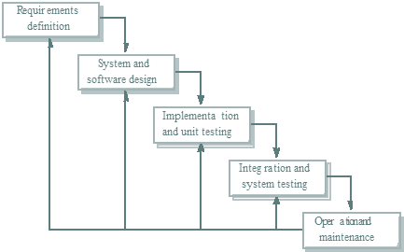
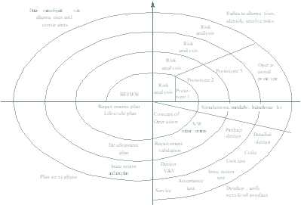
Software Process Models
Waterfall approach | Iterative development | Component-Based Software Engineering CBSE
 |  | assembled form existing components

Slide 38
The Cost of Software Engineering
Depends on:
  The process used, and
  The type of software being developed.
Each generic approach has a different profile of cost distribution.
Roughly 60% of costs are development costs, 40% are testing costs.
For custom software, evolution costs often exceed development costs.

Slide 39
Software costs
Software costs often dominate computer system costs. The costs of software on a PC are often greater than the hardware cost.
• Software costs more to maintain than it does to develop.
For systems with a long life, maintenance costs may be several times development costs.
• Software engineering is concerned with cost-effective software development

Slide 40
3.Maintenance Aspects
  Maintenance
    software maintenance is much more complex
    Corrective maintenance
    Enhancement maintenance
  SE is fairly new (~25 years)

Slide 41
Maintenance is a very costly phase
Maintenance constitutes 67% of total cost
Good software is maintained--Bad software is discarded
Different types of maintenance
  corrective maintenance [20%]:
  adaptive maintenance [20%]:
  perfective maintenance [60%]:

Slide 42
  maintenance [20%]: Removing bug, fcorrectiveixing errors
  enhancement
    adaptive maintenance [20%]: Changes in part of sym as a result of some other change./ change in existing code/ upgrade the sym
    Triggered by changes in environment your software lives in like OS, Hw, Sw dependencies etc..
    Eg: Updating the server, compiler…
    perfective maintenance [60%]: Modification of sw product after delivery to improve performance, before they become faults.
    Eg: when Sw exposed to users they will think of different ways to expand the system, suggest new features etc…

Slide 43
Cost distribution
Custom software development (Bespoke)
Software Model
Cost units
Cost distribution
Software development activity
Waterfall Model
0 | 25 |  | 50 | 75 | 100
Specification |  | Design | Development | Integration and testing
Iterative Development
0 | 25 |  | 50 | 75 | 100
Specification |  | Iterative Development |  | System testing
Component-based Software Engineering
0 | 25 | 50 | 75 | 100
Specification | Development |  | Integration and testing
Development and evolution costs for long-lifetime systems
0 | 100 | 200 | 300 | 400
System development | System evolution

Slide 44
Cost distribution
Generic software development
0 |  |  | 25 |  | 50 |  |  | 75 | 100
Specification |  | Development |  | System testing
Product development costs

Slide 45
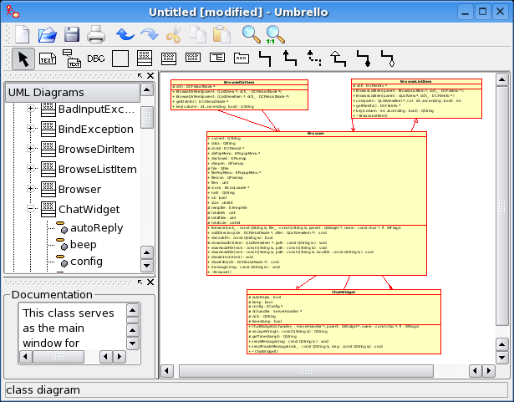
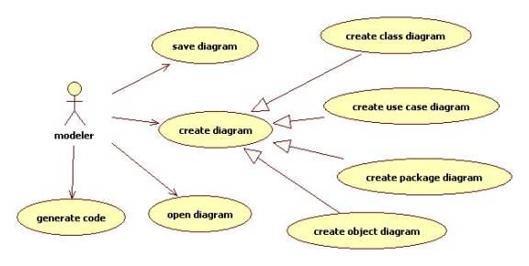
What is CASE?
Computer Aided Software Engineering.
Programs that support:
  Requirements analysis.
  System modeling.
  Debugging.
  Testing.

Slide 46
Attributes of good software
Functional attributes (performance; what the system does).
Non-functional attributes (quality; how the system does it).
Product Characteristic | Description
Maintainability | Evolution qualities such as Testability, extensibility.
Dependability | Reliability, security, safety.
Efficiency | Response time, processing time, memory utilization.
Usability | Easy to learn how to use the system by target users. Efficient to use the system by users to accomplish a task. Satisfying to use by intended users.

Slide 47
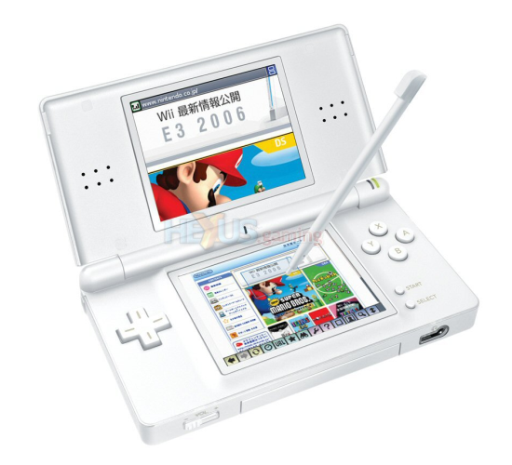






Activity
What are the key attributes for..
Interactive game | Banking system | Cardiac monitor in an ICU unit
Players, score, scenes, theme. | Client accounts, stocks bonds, money transfers. | heart rate, temperature, blood pressure.

Slide 48
Challenges facing software engineering
Challenge | Why? | Software needs to ..
Heterogeneity | Different computers, different platforms, different support systems. | Cope with this variability.
Delivery | Businesses are more responsive → supporting software needs to evolve as rapidly. | Be delivered in shorter time without compromising quality.
Trust | Software is a part of many aspects of our lives (work, study, leisure). | Demonstrate that it can be trusted by users.

Slide 49
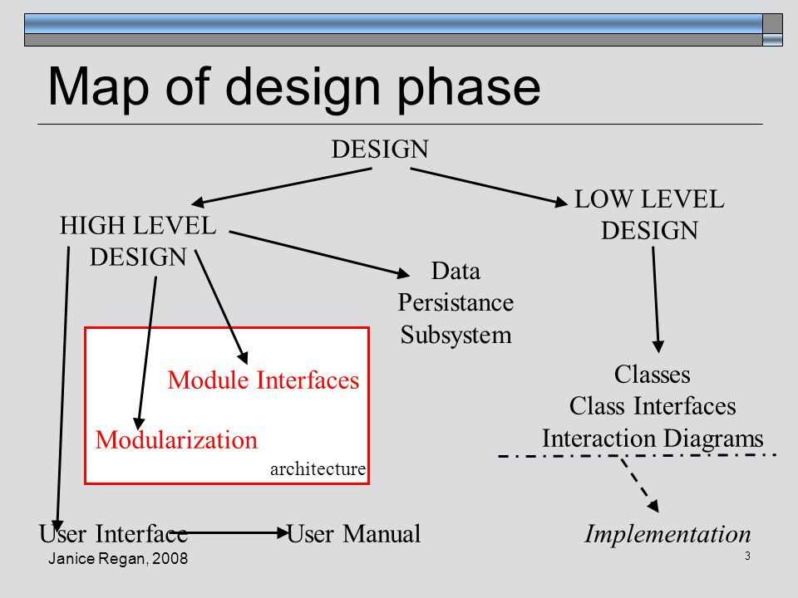
Software Engineering Project Management- KTU Syllabus- Dr.VARGHESE S CHOORLAIL

Slide 50
High Level Design vs Low Level Design
HLD -- High Level Design (HLD) is the overall system design - covering the system architecture and database design.
It describes the relation between various modules and functions of the system. Data flow, flow charts and data structures are covered under HLD.
LLD -- Low Level Design (LLD) is like detailing the HLD. It defines the actual logic for each and every component of the system.
Class diagrams with all the methods and relation between classes comes under LLD. Programs specs are covered under LLD.

Slide 51
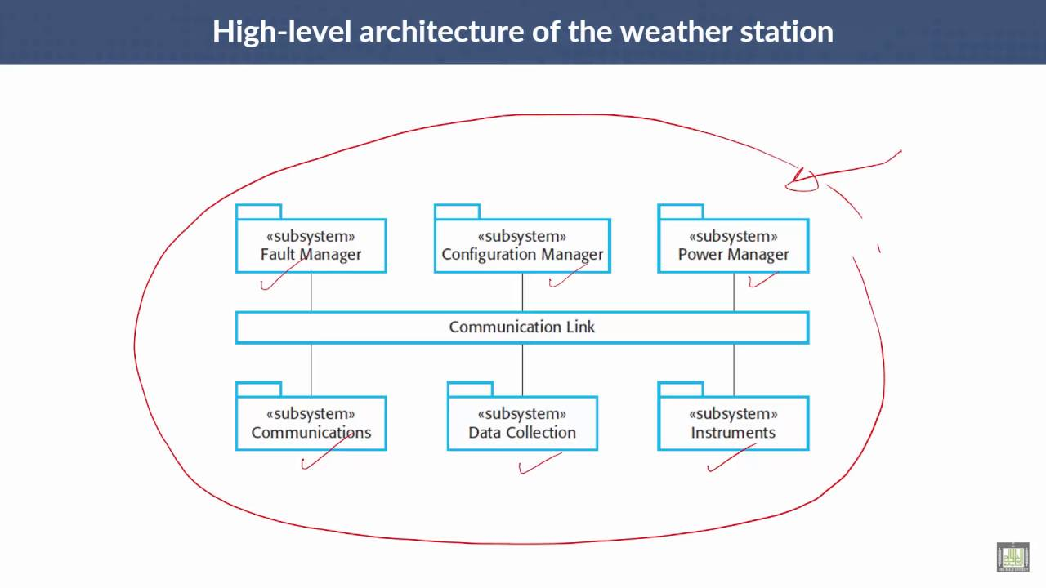

Slide 52
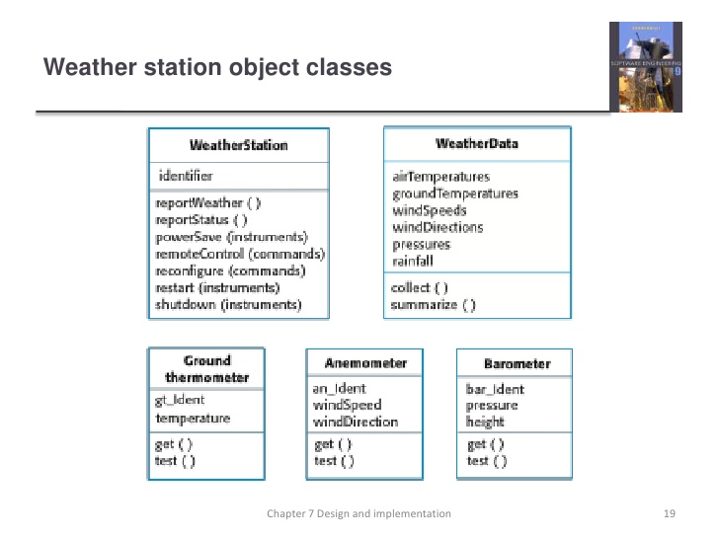

Slide 53
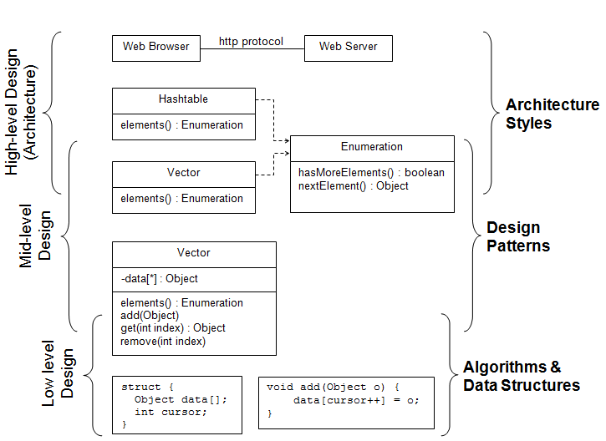

Slide 54
Phases of Life Cycle
  Requirements
  Specifications
  Design
  Implementation
  Integration
  Maintenance

Slide 55
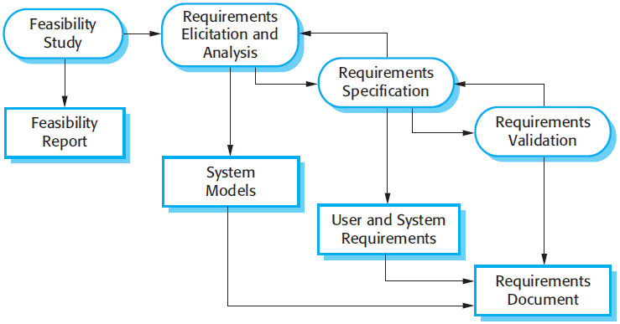
Activities in requirements engineering process
Software Engineering Project Management- KTU Syllabus- Dr.VARGHESE S CHOORLAIL

Slide 56
Four steps
1.Feasibility study:
Whether the identified can be achieved using the current software and hardware technologies, under the current budget, etc.
2.Requirements elicitation and analysis:
The process of deriving the system requirements through observation of existing systems, discussions with stakeholders, etc.
system models and prototypes
3.Requirements specification:
The activity of writing down the information gathered during the elicitation and analysis activity into a document that defines a set of requirements. Two types of requirements may be included in this document;
a.) user and b.)system requirements.
4.Requirements validation:
During this process, our goal is to discover errors in the requirements document. When errors are found, it must be modified to correct these problems.

Slide 57
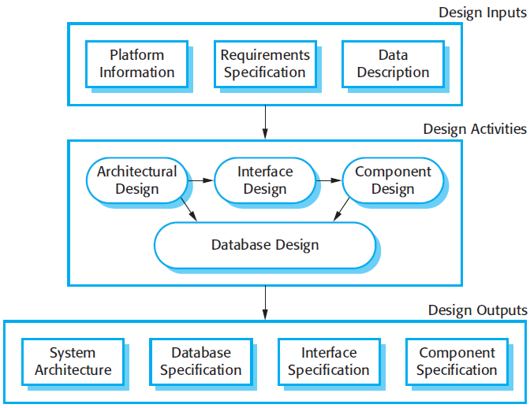
Software Design Process
Software Engineering Project Management- KTU Syllabus- Dr.VARGHESE S CHOORLAIL

Slide 58
The design process are sequential
Interleaved.
A feedback from one stage to another and rework can’t be avoided in any design process.
1.Architectural design:
It defines the overall structure of the system, the main components, their relationships.
2.Interface design:
It defines the interfaces between these components. The interface specification must be clear.
Therefore, a component can be used without having to know it’s implemented. Once the interface specification are agreed, the components can be designed and developed concurrently.

Slide 59
3.Component design:
Take each component and design how it will operate, with the specific design left to the programmer, or a list of changes to be made to a reusable component.
4.Database design:
The system data structures are designed and their representation in a database is defined.
This depends on whether an existing database is to be reused or a new database to be created.

Slide 60
References
PRESS&SUN-BULLETIN, The Binghamton Press Co., Binghamton, NY, October 1,1999.
“Software Hell: Is there a way out?”, BUSINESS WEEK, December 6, 1999.
IEEE Standards Collection: Software Engineering, IEEE standard 610.12-1990, IEEE 1993.
Sommerville, Ian “Software Engineering”, 9th edition, Addison-Wesley.

